Slide 1




Slide 2



Mini Project Group No:-13 Dry And Wet
Garbage Segregation
Prof. A.N.Shah [Guide]
Abhishek Kolekar Tejas Patil Shrikant Hadpad Sagar Raghoji
19151269
19151270
19151275
16151237

Slide 3
I
INTRODUCTION
II
IV
SWOT ANALYSIS
V
FUTURE IMPROVEMENTS
VI
COMPONENTS USED
III
VII
REFERENCES
WORKING
CONCLUSION
CONTENTS

Slide 4


INTRODUCTION
Economic value
Compost & recycle
Segregate waste at source
The purpose

Slide 5

LITERATURE SURVEY
Existing System
Limitations in
Existing System
Proposed System
Advantages over
Existing System

Slide 6

MAIN GOAL
Empowered Swatch Bharat Mission
Support Digital India
Smart City
Providing a smart technology for waste management system.

Slide 7








COMPONENTS USED
Raspberry Pi 3b+ Soil Moisture Sensor IR Sensor
Servo Motor

Slide 8
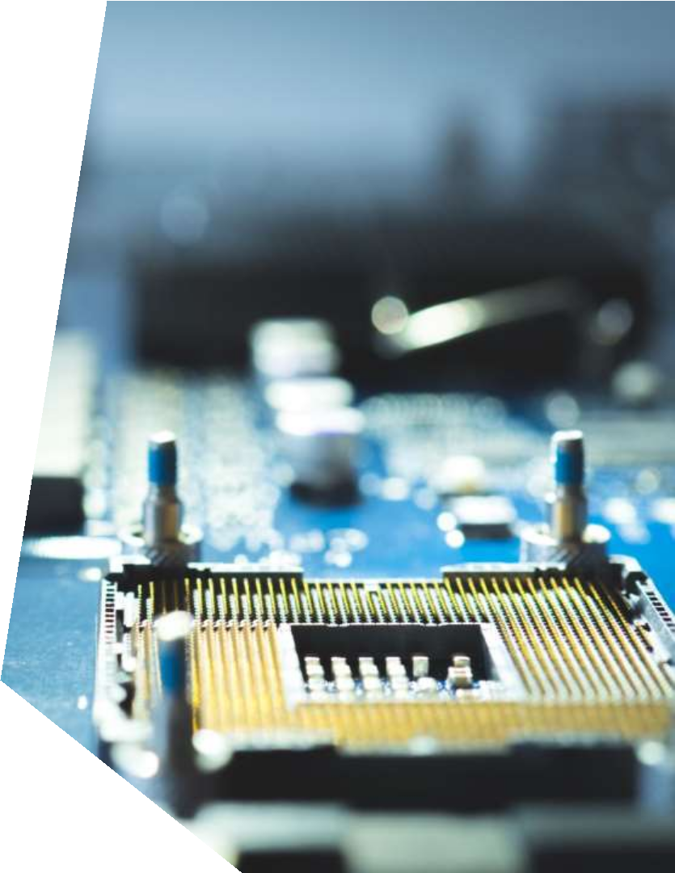









SOFTWARE USED
VNC VIEWVER
ADVANCE IP SCANNER
ETCHER

Slide 9


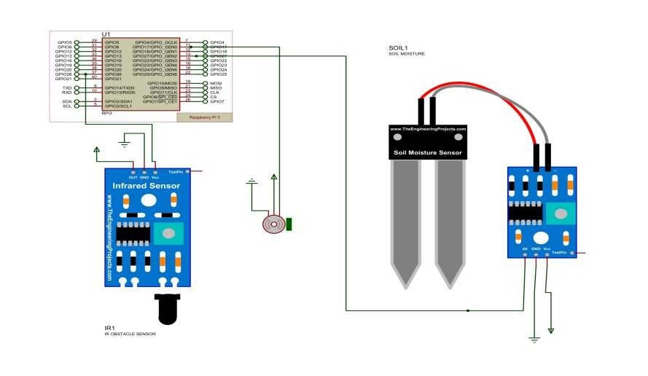
CIRCUIT DIAGRAM

Slide 10


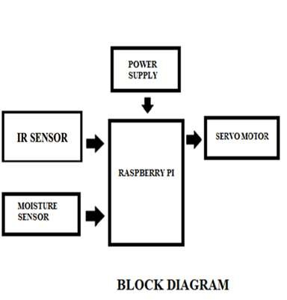
POWER
SUPPLY
IR SENSOR
SERVO
MOTOR
Raspberry
PI 3B+
MOISTURE
SENSOR
BLOCK DIAGRAM

Slide 11





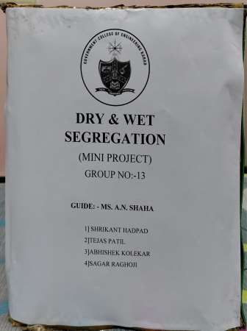
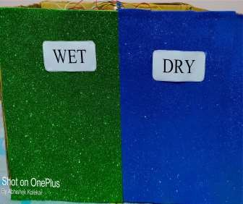
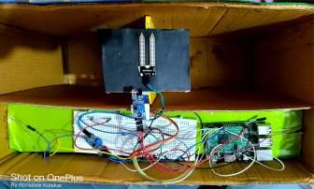

Slide 12
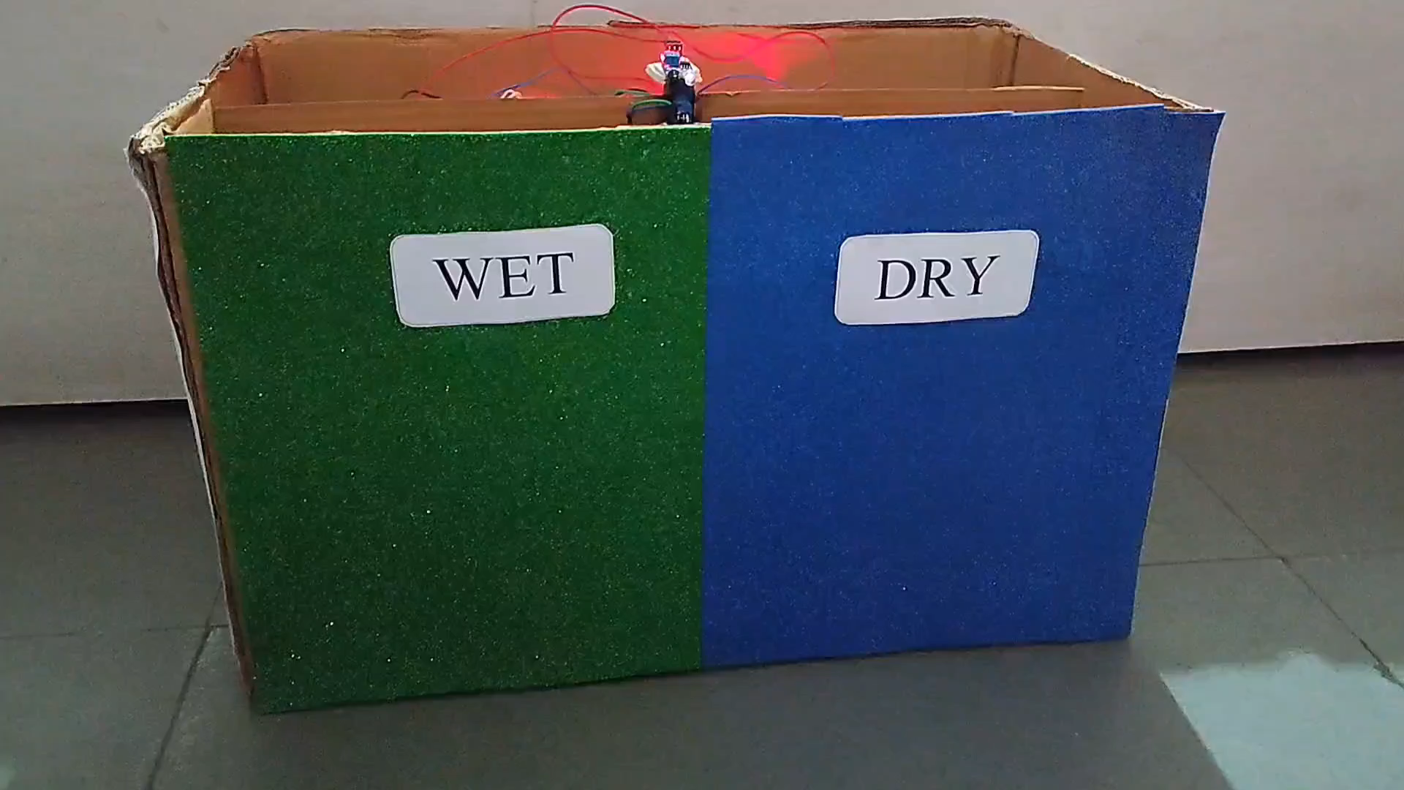
WORKING

Slide 13
STRENGHTS
Less efforts in segregation
Low cost
WEAKNESS
Restricted use (Dry/Wet)
Updated Technologies
OPPORNTUNITIES
Huge Market demand
3R's can be implemented easily
THREATS
Many competitors available at
market
Cost reduction for sustainability

Slide 14
FUTURE IMPROVEMENTS
Multiple Segregation
Waste Type Detection
Industrial Use
Notification System

Slide 15
Malls/Supermarkets
Local Shops
TARGETED CUSTOMER
Local Authorities
E-Commerce Websites

Slide 16





MARKETING STRTAGIES
Online
Advertisement
Phone
Home to home

Slide 17
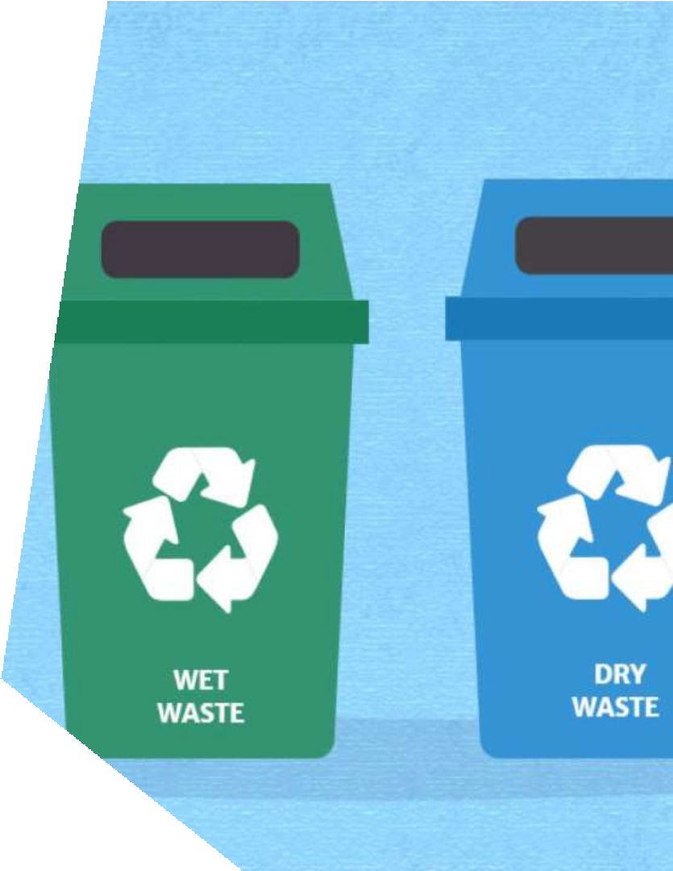
SEGREGATION OF WASTE
WET
DRY
Wet waste is all the
kitchen waste.
This includes vegetable peels, used tea, fruits, leftovers.
These are biodegradable organic waste that can be composted.
Paper, glass, plastic, cardboard, rubber, metal, food packaging material.
Dry waste can be recycled.

Slide 18




CONCLUSION
Redesigning old Dustbin into Multipurpose system
to fulfill customers needs and requirements.
It ultimately helps to keep cleanliness in the
society.
The smart waste segregation improves the garbage collection system implemented across the country with less human intervention.

Slide 19

REFERENCE
Raspberry Pi Official Beginner's Guide Second edition
IEEE research papers Automatic waste segregator 2017
IEEE research IoT based Automatic Waste segregator 2019

Slide 20


